Slide 1
Receipt and Invoice
Digitizer

Slide 2
My contribution- frontend development
(login page & forgot password)
Technologies Used: HTML, CSS
Designed and developed responsive user interfaces using HTML and CSS.
Created a clean and user-friendly Login Page with proper input fields and layout.
Designed the Forgot Password page to allow users to reset credentials easily.
Used HTML to structure web pages and CSS for styling, alignment, and layout consistency.
Ensured simple navigation and consistent design across authentication pages.

Slide 3
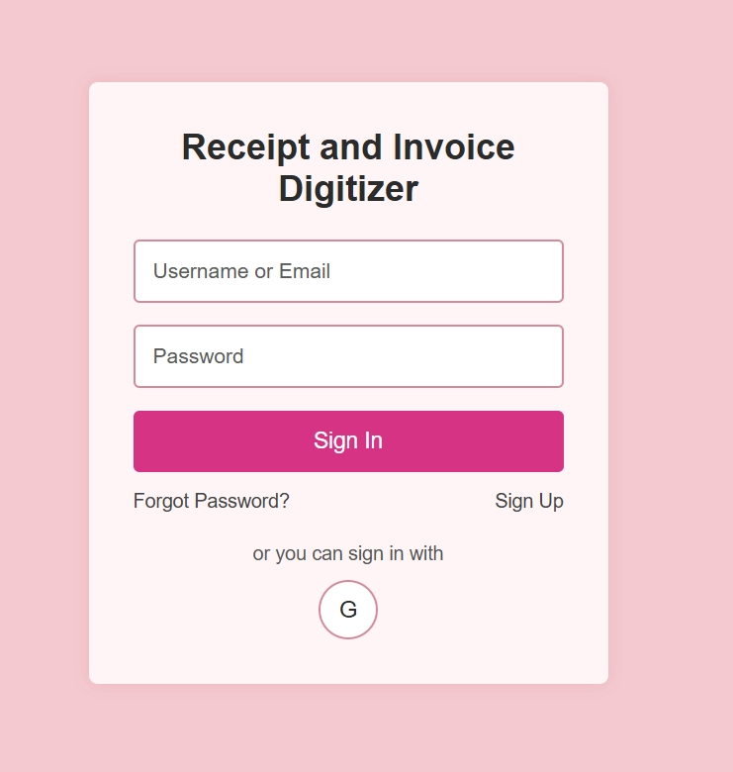
Add a Slide Title - 4
Login Page Design
Username or Email field for user identification
Password field for secure authentication
Sign In button to access the application
Forgot Password option for credential recovery
Sign Up option for new user registration.

Slide 4
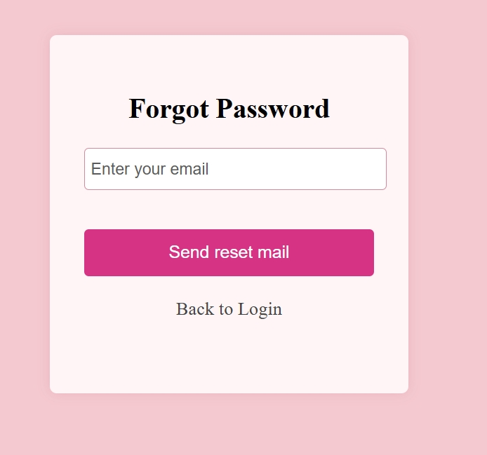
Forgot password Design
The forgot password page has an email input field for verification.
It provides an option to send a password reset email.
A back-to-login option is included for easy navigation.

Slide 5
Login & Forgot Password Page –
HTML implementation
HTML was used to structure the Login and Forgot Password pages
Forms and input fields were used to collect user credentials <form>,<input>
Buttons handled actions like Sign In and password reset.<button>
placeholders improved clarity and accessibility.
Anchor tags enabled navigation between related pages.<a>
Semantic elements ensured a clean and readable layout.

Slide 6
Login & Forgot Password Page –
CSS Styling
Used CSS for layout, alignment, and spacing.
Styled input fields and buttons for better usability.
Applied consistent colors, fonts, and design across pages.
Added hover and focus effects for improved user interaction.
body {
background-color: #f4c9cf;
height: 100vh;
}
.send_email:hover {
background: #b92d70;
}

Slide 7
THANK YOU
K.THRISHALA

